Slide 1
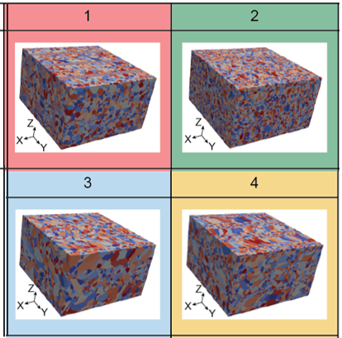
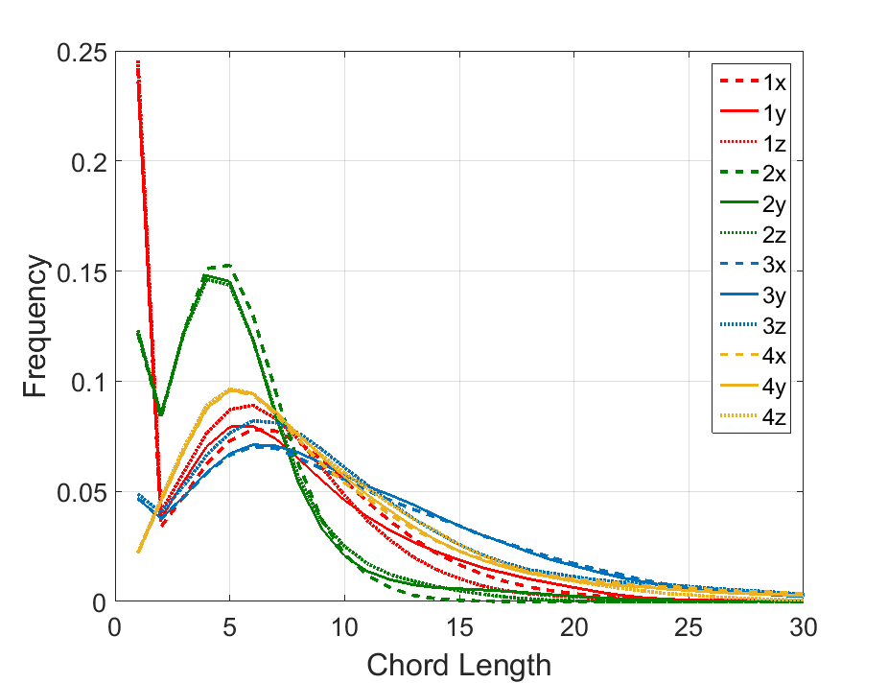
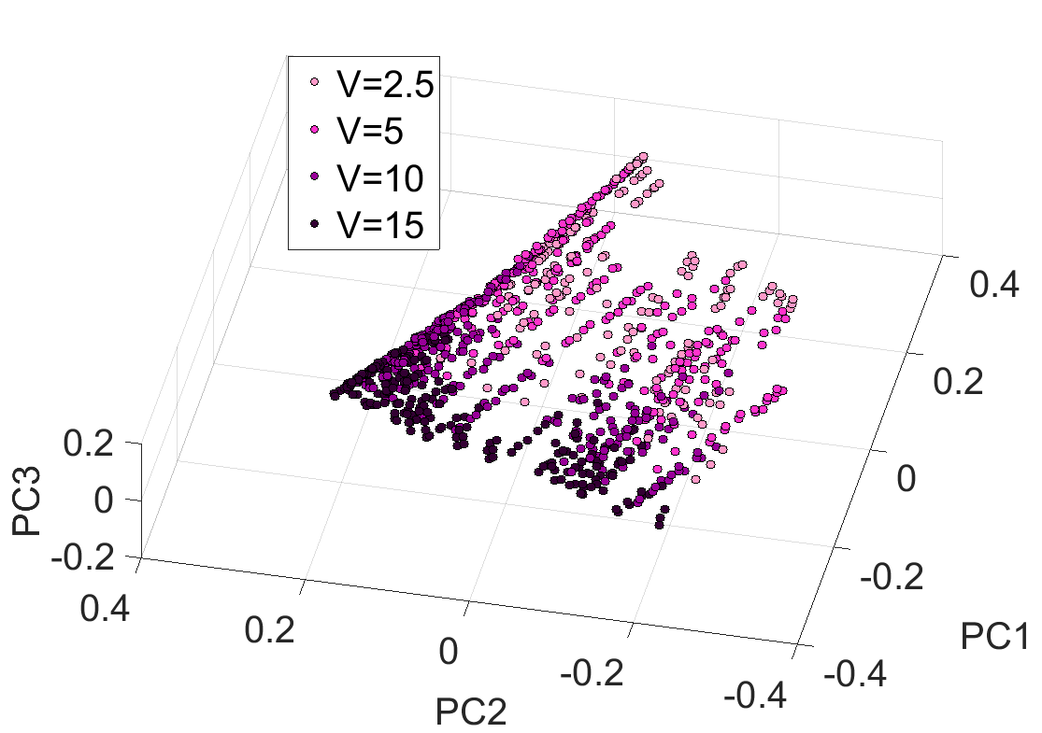
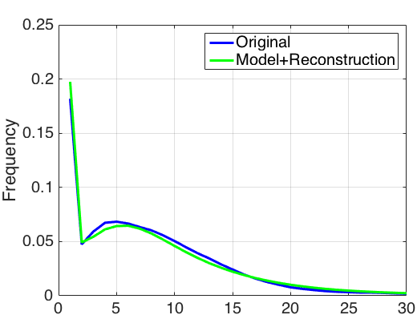
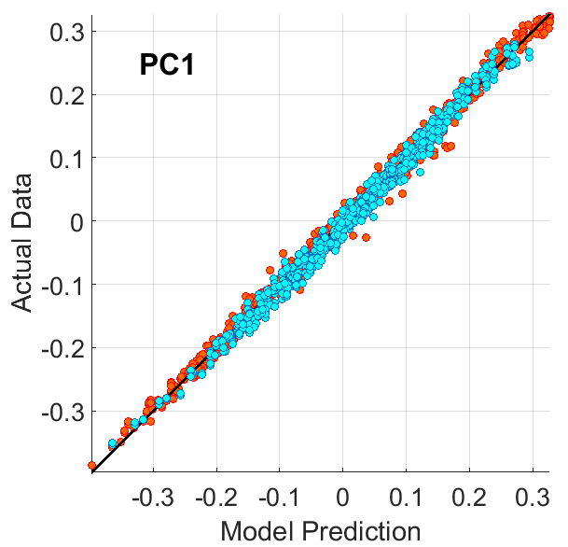
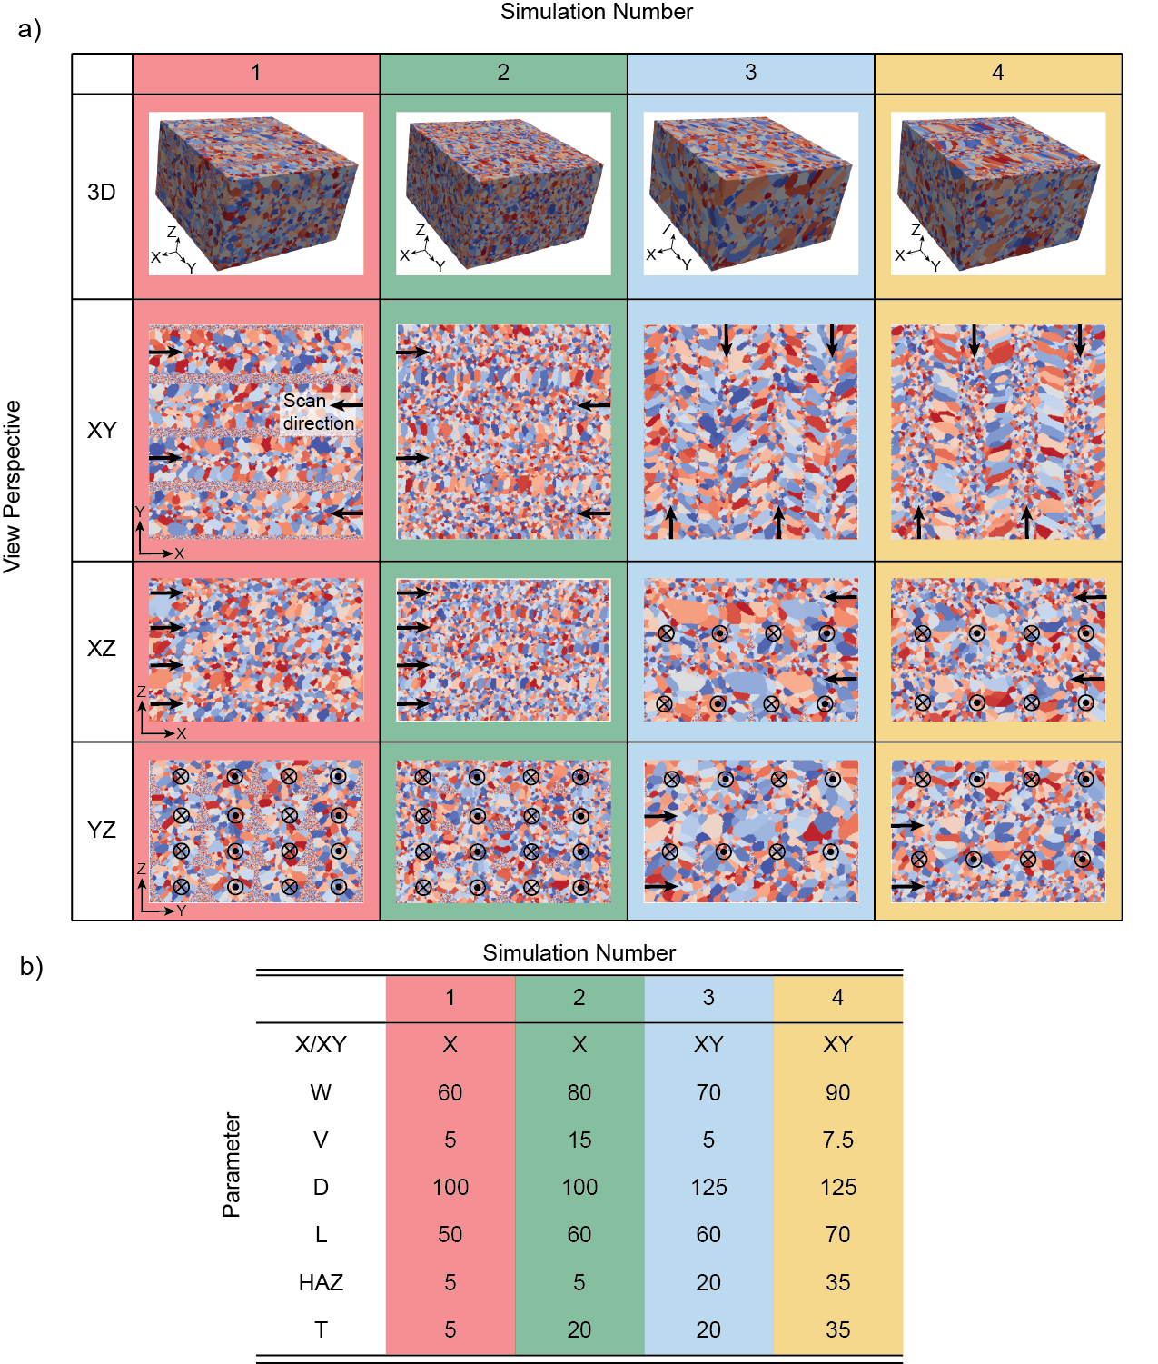
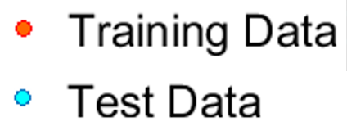
SYNTHETIC ADDITIVE MANUFACTURING MICROSTRUCTURE CREATION
MEASURED CHORD LENGTH DISTRIBUTIONS
PRINCIPLE COMPONENT ANANLYSIS
Extraction of Process-Structure Linkages Using a Data Science Approach
regression
input
output
ADDITIVE MANUFACTURING PROCESSING PARAMETERS
PROCESSING PARAMETER DRIVEN DATA MODEL PC_{i} = f(W,V,D,L,HAZ,T)
DATA MODEL VS. SIMULATION

